Slide 1
Drone Building Inspections
Yinshuo Feng, Luying Ruan, Jim Stiegler, Hua Tong
EC 601 A2

Slide 2
Mission
Enable the Architecture, Engineering, and Construction (AEC) industry to safely and efficiently inspect structures to detect and characterize potential anomalies that require attention.

Slide 3
Sprint 2 Goals
Get familiar with
Image processing tools and experimenting with various APIs
Drone hardware and software
Work on the capability that can detect cracks, erosion, and other potential issues that would be concerning

Slide 4
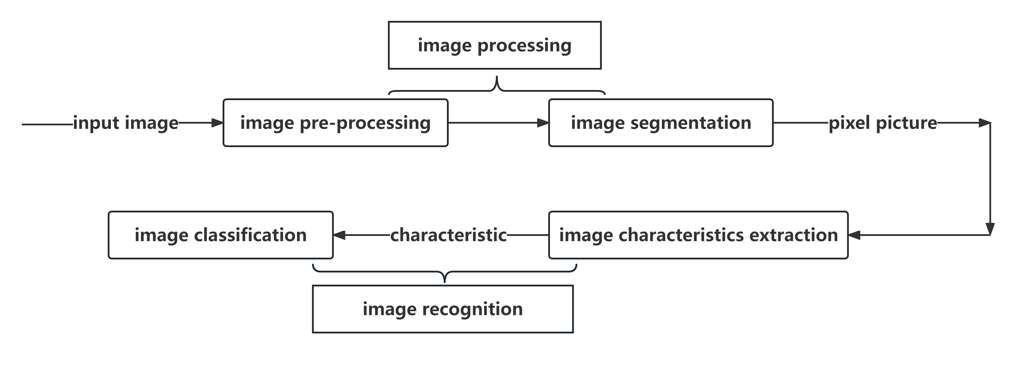
Image Recognition
The image recognition process is divided into two parts: image processing and image recognition.

Slide 5
Edge Detection
The purpose of edge detection is to detect and identify a collection of pixels with drastic brightness changes in the image. Edge detection greatly reduces the amount of data in the source image, eliminates information irrelevant to the target, and retains important structural attributes of the image.

Slide 6
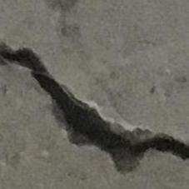
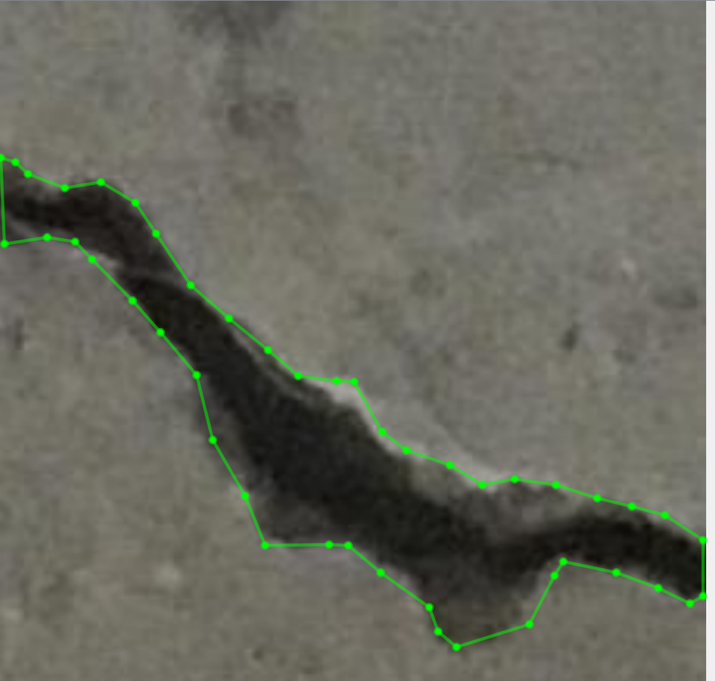
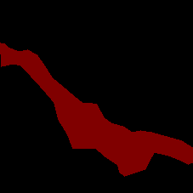
Where are we now?
Credit: scopito.com
Credit: aeromotus.com
Credit: roboticsbusinessreview.com
Credit: qlddrones.com.au
Notes:
Drones are being used in:
Roof inspections
Construction
Tower, power lines, cellular inspections
Solar panel inspections
And other fields

Slide 7
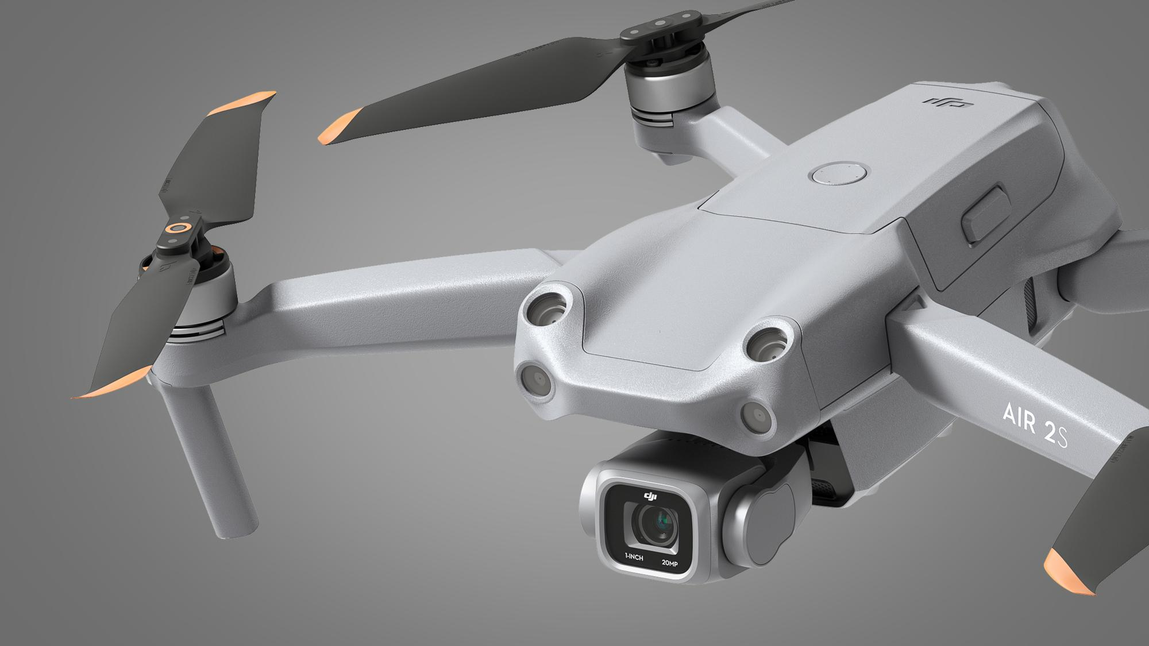

How?
Credit: techradar.com
Credit: autodesk.com
Hardware
Software
Notes:
Larger term project would include integrating the capability onto drones and automating drone collection of projects, but for the time being, our team will focus on the software application, using ML and object identification, as well as a UI to assist with reviewing the results

Slide 8
For Datasets part:
The main idea of our make_dataset.py: prepare image and label data for a semantic segmentation task and also organize the data into training, validation, and also testing sets.
Creating Directories: check all the directories whether exist and if not, create them;
Iterating Through JSON Files: for each JSON file, reads data and extracts the image data, label data, and other relevant information.
Processing JSON Data: decode the image data and then convert them into Numpy array and then generate the label array.
Saving image and Label Data: create the label image and save it as the PNG files.

Slide 9
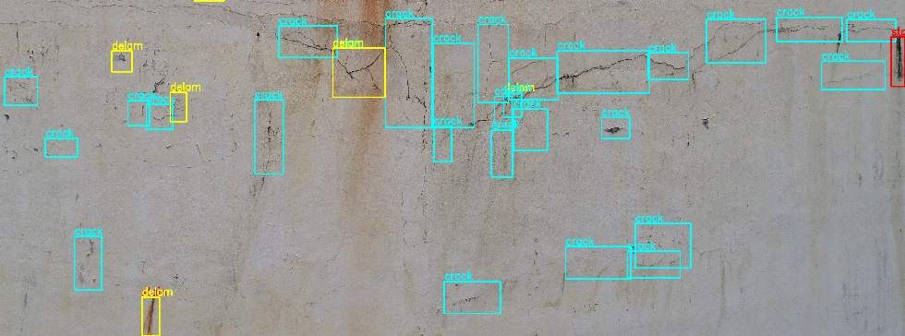
Sprint3 Goals
Getting worked on the Establish the CNN model to train the dataset and self-detect that whether is the crack or not.
the next milestone is making the thing like this:

Slide 10
Questions?
?

